Slide 1
A century later, why does Chaplin still matter?
“Even now, my voice is reaching millions throughout the world. Millions of despairing men, women, and little children…”
-Charlie Chaplin(The Great Dictator)
Charlie Chaplin was famous in a way that no one had been before; arguably, no one has been as famous since. At the peak of his popularity, his mustachioed screen persona, the Tramp, was said to be the most recognized image in the world. His name came first in discussions of the new medium as popular entertainment, and in defenses of it as a distinct art form—a cultural position occupied afterward only by the Beatles, whose own era-defining popularity never equaled Chaplin’s. He’s the closest thing the 20th century produced to a universal cultural touchstone.

Slide 2
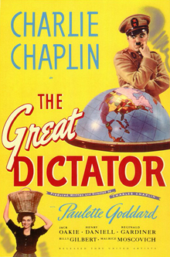
Film histories—a good chunk of which have an image of Chaplin on the cover—will invariably tell you that Chaplin’s mass popularity was owed to the way in which the Tramp represented a destitute everyman. His films turned hunger, laziness, and the feeling of being unwanted into comedy.
This version of Chaplin’s rise puts the onus of responsibility on the audience, as he’s reflecting their feelings and their sense of humor. This is a common approach, because it’s easier to be authoritative while reporting popular culture than while explaining it.

